Slide 1
Optimizing Delivery Logistics for E-Commerce Warehouses
Ruchira Kanawade
Namratha Eti
Viridiana Radillo
Vishnu Sai Nandan Tummala
Rahul Dipak Talreja

Slide 2
Topic selection
Our topic is optimizing delivery logistics for e-commerce warehouses in the United States. We aim to reduce delivery costs while ensuring timely shipments, focusing on improving operational efficiency and customer satisfaction.
Importance:
Enhance operational profitability
Improve customer satisfaction

Slide 3
Objective of the problem
Minimize total delivery costs while ensuring that shipments reach customers on time.
Identify the factors contributing to delayed deliveries and improve delivery prediction accuracy.
Develop recommendations for optimal shipment modes and logistics planning to enhance customer satisfaction.

Slide 4
Practical Implications of solving the problem
Cost Reduction: Through optimized shipment mode and warehouse selection.
Improved Timeliness: Higher customer satisfaction rates
Operational Efficiency: Streamlined processes to handle higher order volumes.
Sustainability: Reduced carbon footprint via route optimization.

Slide 5
Known and unknown variables
Known Variables:
Warehouse block
Mode of shipment
Customer care calls
Product importance
Gender
Discount offered
Weight in grams
Prior purchases
Product importance
Unknown variables:
Future delays in shipment
Ideal shipment mode and warehouse allocation for cost reduction
Factors leading to variability in customer satisfaction.

Slide 6
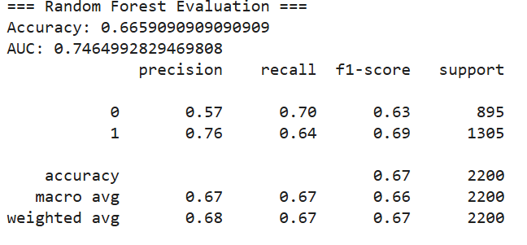
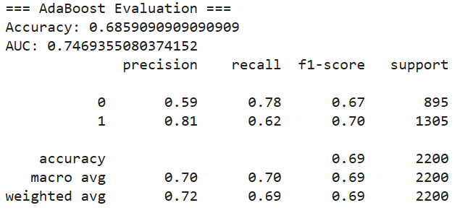
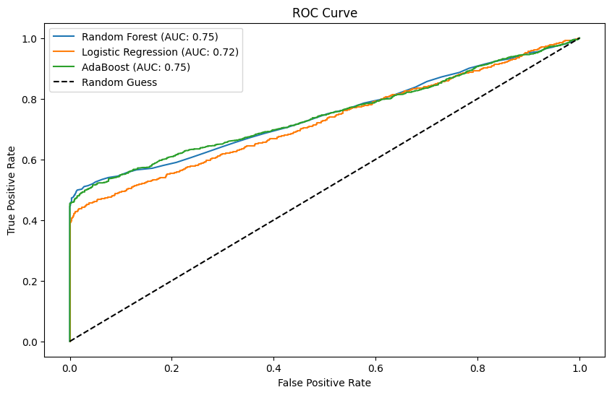
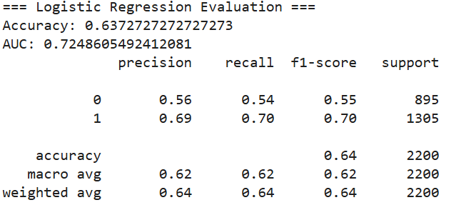
Predictive Models

Slide 7
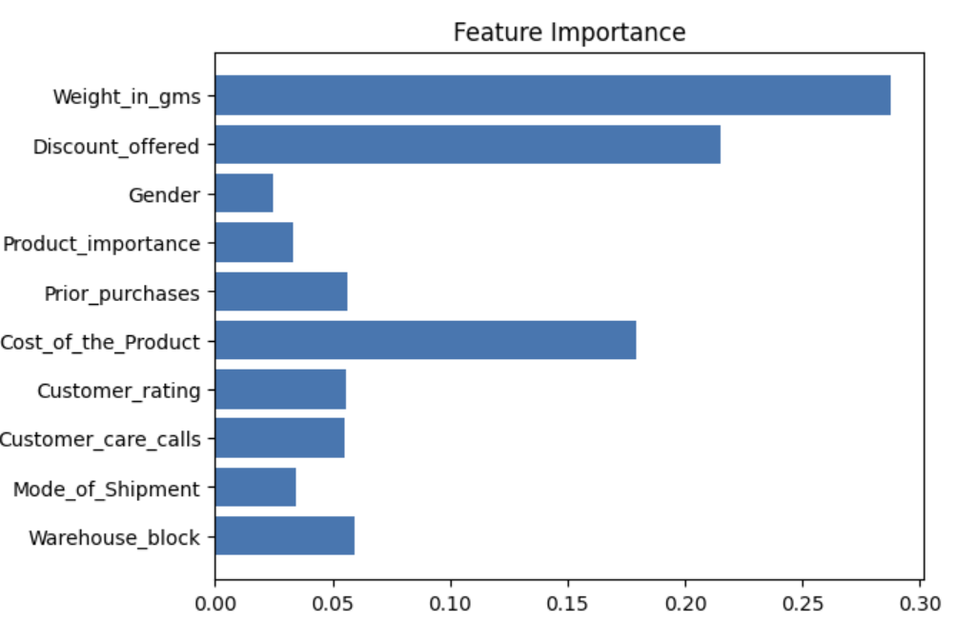
Feature Importance (Random Forest)

Slide 8
Prescriptive Analytics
Formulating LP model
Total Demand:
X₁+x₂+x₃ = 700
Capacity Constraints:
Air: x₁≤100
Ship: x₂≤300
Road: x₃≤500
Non-negativity Constraint: X₁+x₂+x >= 0
Decision Variables:
Air units shipped : X₁​=C2
Ship Units Shipped: X₂=C3
Road Units Shipped: X₃=C4
Objective Function: Min: 10X₁+5X₂+2X₃

Slide 9
Optimal Solution
Air Units Shipped: 000
Ship Units Shipped: 200200200
Road Units Shipped: 500500500
Air Units Shipped: 0
Ship Units Shipped: 200
Road Units Shipped: 500
The optimal solution indicates that to minimize shipping costs while satisfying the constraints, it is best to ship:
All 200 units by ship, due to its lower cost per unit compared to air.
All 500 units by road, which also has a lower cost and meets capacity requirements.
No units should be shipped by air as it does not provide a cost advantage in this scenario.

Slide 10
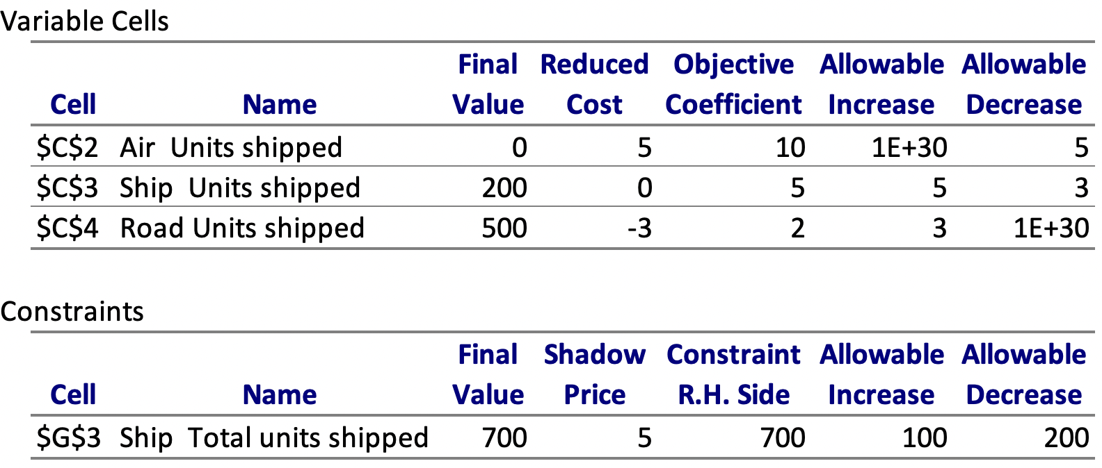
Sensitivity Analysis
Air Mode: Too expensive unless its cost per unit decreases to $5.
Ship Mode: Currently cost-effective but could lose priority if its cost increases above $10.
Road Mode: Most cost-effective; can tolerate up to a $5 per unit cost before being replaced by ship or air.
Demand Constraint: Increasing demand raises costs by $5 per additional unit.

Slide 11
Trade-off Analysis and Recommendations
Air Units Shipped: 000
Ship Units Shipped: 200200200
Road Units Shipped: 500500500
Trade-Off Analysis
Cost vs. Shipment Capacity: Using road maximizes cost-efficiency, but relaxing the capacity constraints of ship or air could alter the solution.
Flexibility vs. Cost: Increasing the allowable capacity of ship might allow for lower total costs if road costs rise.
Recommendations
Dynamic Costs: Explore seasonal changes in shipment costs.
Environmental Impact: Introduce carbon emissions as a factor to evaluate sustainability trade-offs.
Multi-Period Demand: Extend the model for multiple time periods to capture demand fluctuations.

Slide 12
Thank you

